Slide 1

Week 5: Non-Linear Classification and Deep Learning
Part 3- Overfitting and Underfitting
Dr Maha Saadeh

Slide 2
Avoiding problems
Overfitting:
When we train a model on a specific data set, it understands it too well and can’t adapt to new data.
Can be avoided by augmenting training data with more variance data, and simplifying / regularising the model.
Underfitting:
When a model is too basic, preventing it from identifying dominant trends.
Increasing training time can reduce risk.
Make data less uniform so trends can be identified be the model – opposed to the model being told.
Training dataset – low error rate
Test dataset – high error rate
Overfitted model

Slide 3
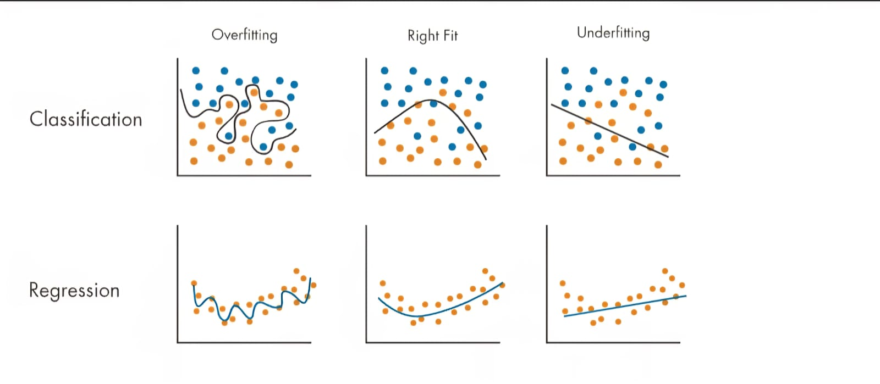

Slide 4
Bias
Bias error results from simplifying the assumptions used in a model so the target functions are easier to approximate.
Bias is the amount that a model’s prediction differs from the target value, compared to the training data.
A high level of bias can lead to underfitting, which occurs when the algorithm is unable to capture relevant relations between features and target outputs

Slide 5
Variance
Variance indicates how much the estimate of the target function will differ if different training data were used.
Variance measures the inconsistency of different predictions using different training sets — it’s not a measure of overall accuracy.
High Variance can lead to overfitting to unrepresentative training data

Slide 6
Overfitting and Underfitting
trade-off is well known:
Increasing bias decreases variance,
and increasing variance decreases bias.
Data scientists have to find the correct balance.
When building a supervised machine-learning algorithm, the goal is to achieve low bias and variance for the most accurate predictions.
Data scientists must do this while keeping underfitting and overfitting in mind. A model that exhibits small variance and high bias will underfit the target, while a model with high variance and little bias will overfit the target.

Slide 7
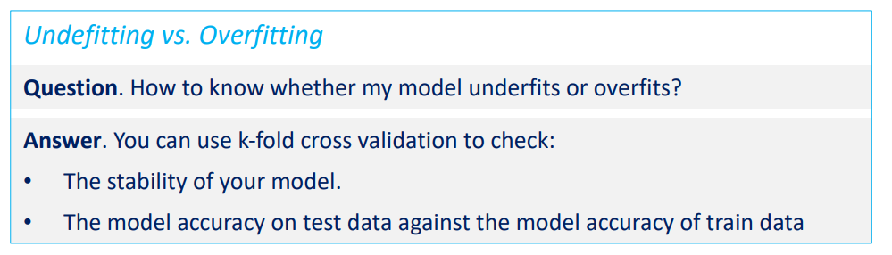
Bias-Variance tradeoff
If the average prediction values are significantly different from the true value based on the sample data, the model has a high level of bias.
If the prediction values for different folds are significantly different from each other, the model has a high level of variance. (not consistent)

Slide 8
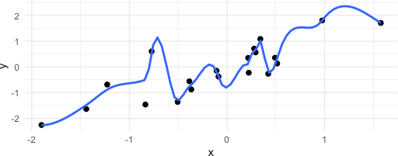
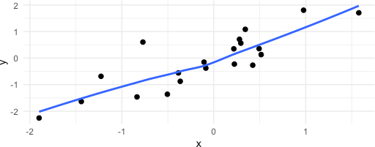
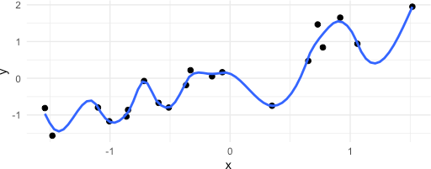
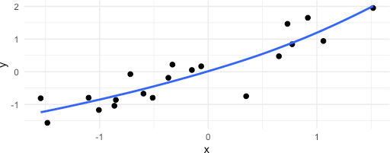
Accuracy of the model
𝑆𝑒𝑡_{𝐴} of observations
Fitting the noise
Fitting the true pattern
Fitting the noise
Fitting the true pattern
𝑆𝑒𝑡_{𝐵} of observations

